Slide 1
APPLYING HYBRID RAG TECHNOLOGY IN A CHATBOT FOR CONSULTING ON SEXUALLY TRANSMITTED DISEASES (STDs)
MINISTRY OF EDUCATION AND TRAINING
CAN THO UNIVERSITY
UNIVERSITY THESIS DEFENSE
TOPIC NAME
Name: Le Huynh Dang
Student code: B2111977
Instructor: Dr. Lam Nhut Khang
Major: Information and technology

Slide 2
APPLYING HYBRID RAG TECHNOLOGY IN A CHATBOT FOR CONSULTING ON SEXUALLY TRANSMITTED DISEASES (STDs)
MINISTRY OF EDUCATION AND TRAINING
CAN THO UNIVERSITY
UNIVERSITY THESIS DEFENSE
TOPIC NAME
Name: Le Huynh Dang
Student code: B2111977
Instructor: Dr. Lam Nhut Khang
Major: Information and technology

Slide 3
TABLE OF CONTENT
01
INTRODUCTION
02
METHODOLOGY
03
IMPLEMENTATION
04
EXPERIMENTS AND
EVALUATION
05
CONCLUSION AND
FUTURE WORK

Slide 4
CHAPTER 1 - INTRODUCTION
Urgency of the topic
√ Necessary, high sensitivity: STI/STD questions are common but stigmatized; many people avoid clinics and want confidential, judgment-free guidance.
√ Information quality gap: Official guidance (CDC/WHO/NHS) is scattered, technical, and not tailored; Vietnamese materials are uneven and often outdated
√ Risk of misinformation: Social media contains unverified advice; an authoritative system with citations is safer.

Slide 5

CHAPTER 2 - THEORETICAL THESIS
2.1 Retrieval‑Augmented Generation (RAG)
Idea: retrieve relevant passages from knowledge base → append to prompt → LLM generates citation-based answers.
Benefits: reduce illusions, update by source; control content and citations.
Key factors: data quality, chunking/metadata strategy, and retrieval algorithm.

Slide 6



CHAPTER 2 - THEORETICAL THESIS
2.2 Data pipeline & chunking

Slide 7
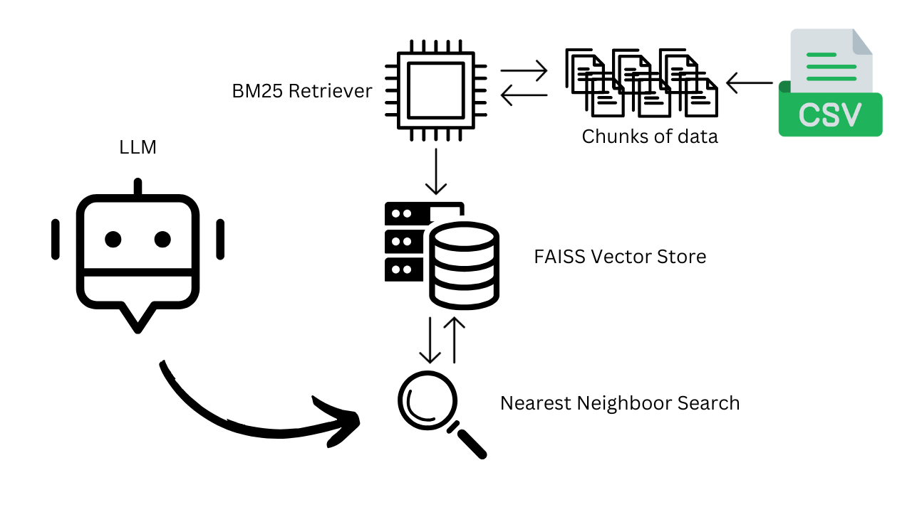
CHAPTER 2 - THEORETICAL THESIS
2.3 BM25 and FAISS indexing

Slide 8

CHAPTER 2 - THEORETICAL THESIS
2.4 Hybrid Recursion & RRF
BM25 (lexical)
Top-k
RRF Fusion
Final ranked
FAISS (semantic)
Top-k
Merge by rank: score_RRF = Σ 1/(k + rank_i); prioritize consensus, avoid scale deviation.

Slide 9







CHAPTER 2 - THEORETICAL THESIS
2.5 GraphRAG

Slide 10
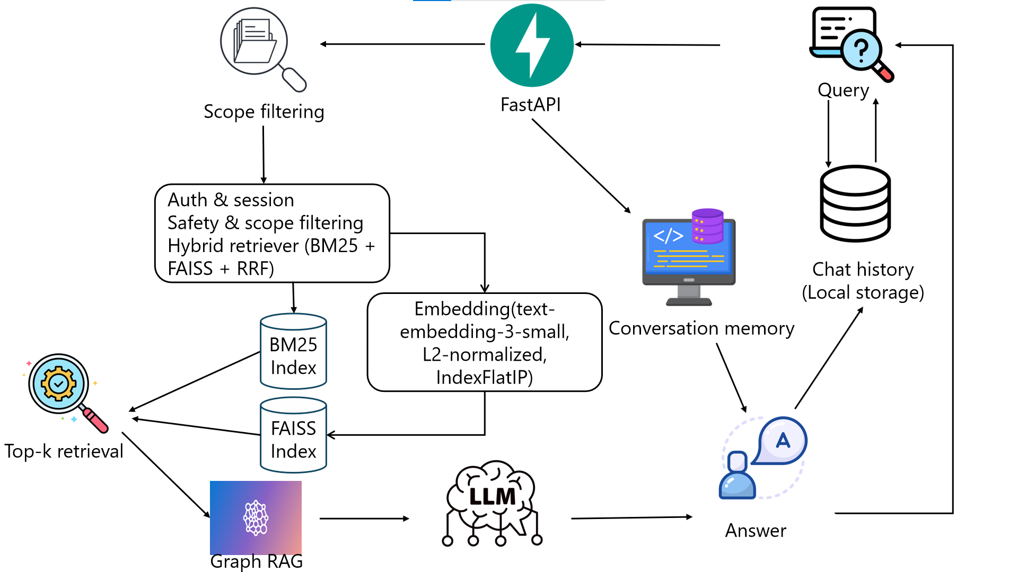
CHAPTER 3 - METHODOLOGY
3.1 Overall architecture

Slide 11
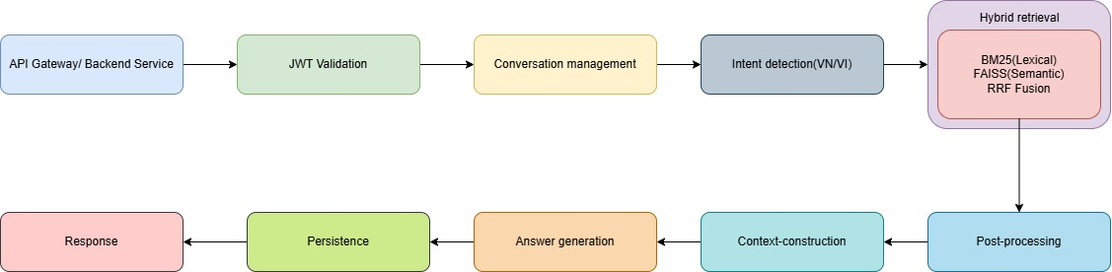
CHAPTER 3 - METHODOLOGY
3.2 Chat work-flow

Slide 12

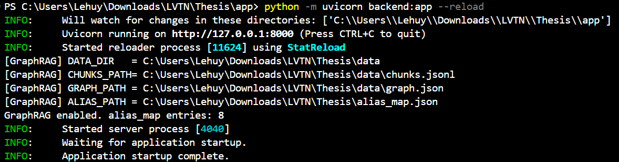

CHAPTER 4 - EXPERIMENTS AND EVALUATION
1. Experiments

Slide 13
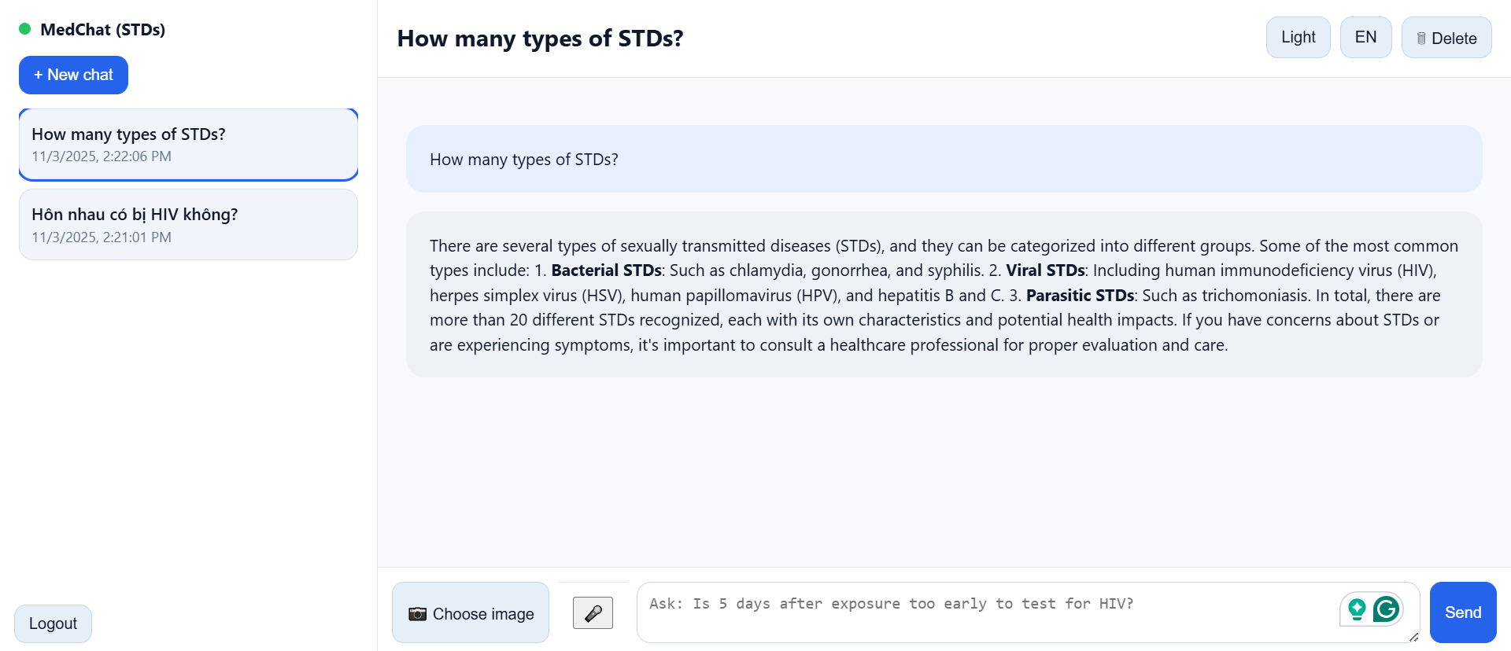
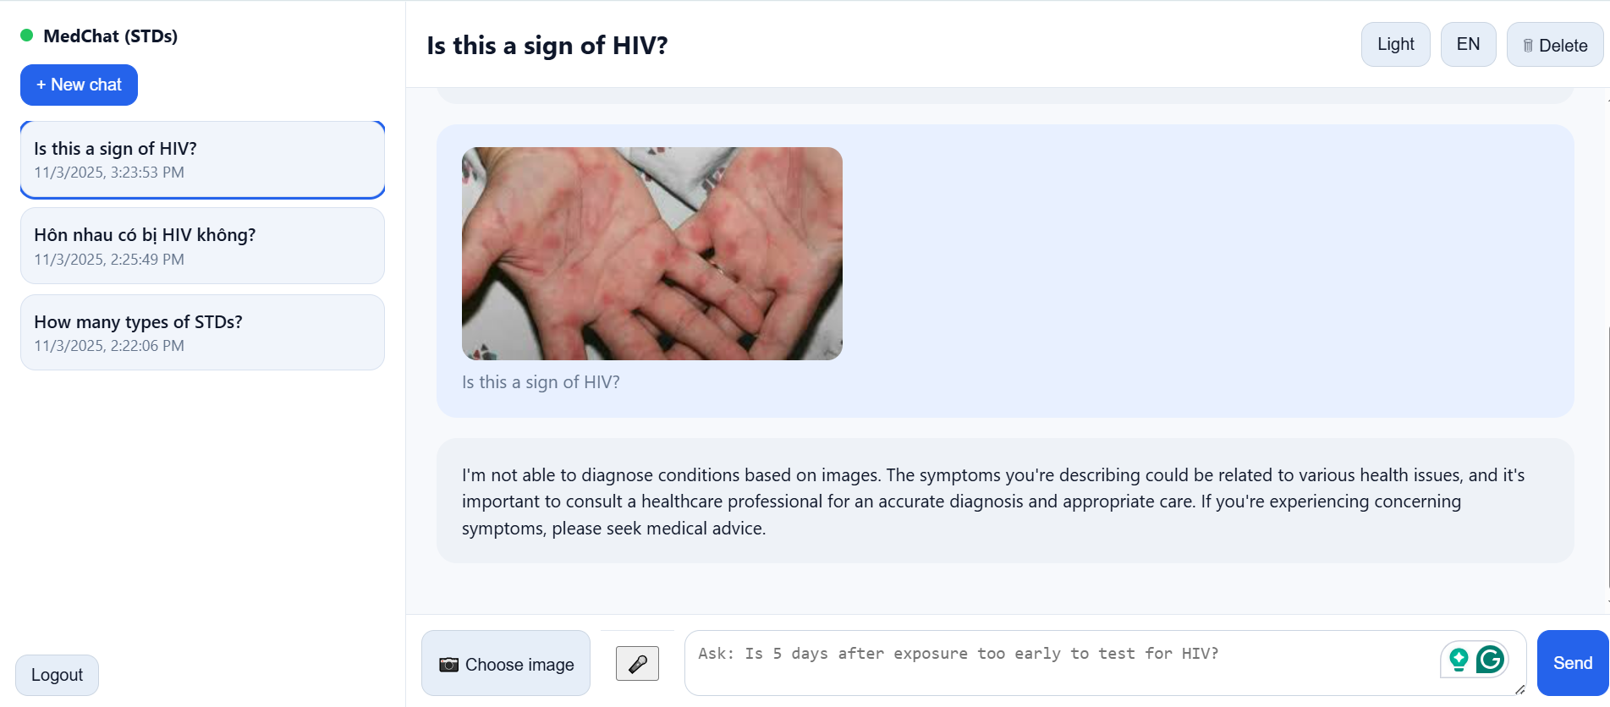
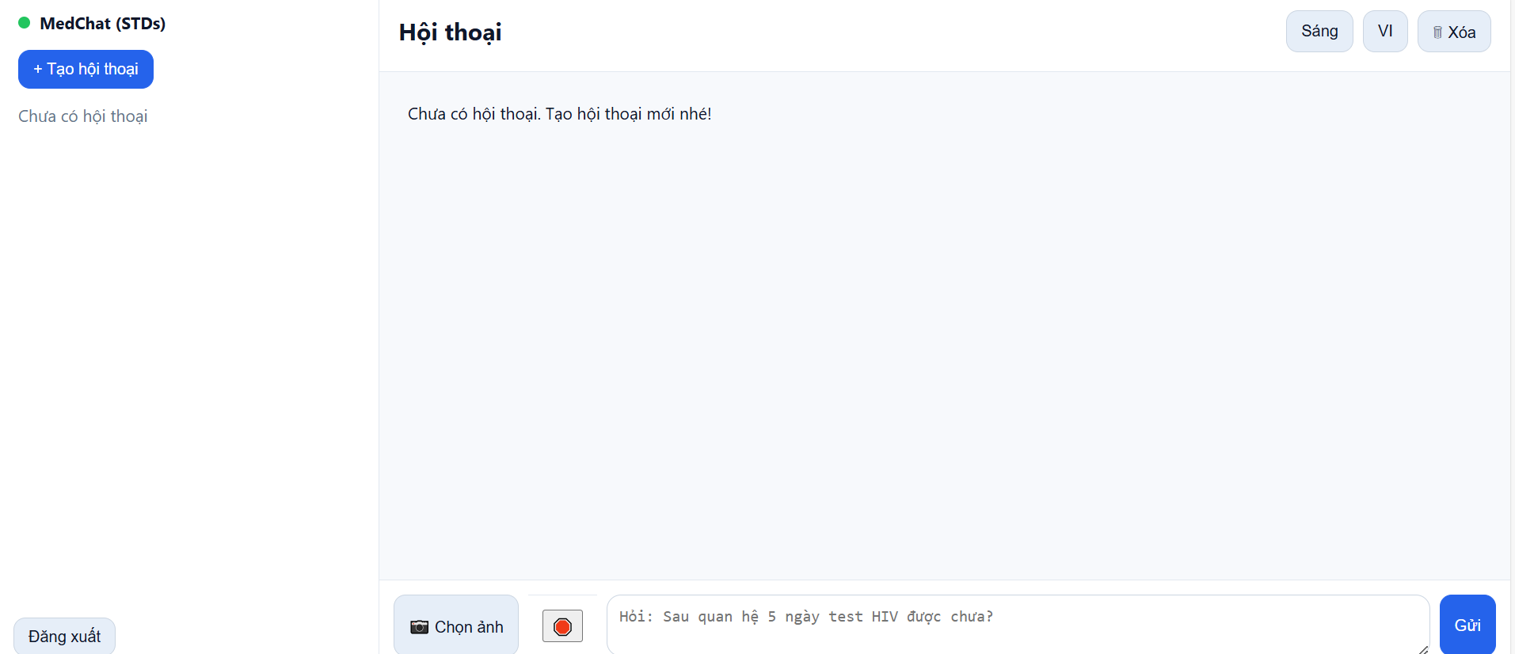
CHAPTER 4 - EXPERIMENTS AND EVALUATION
1. Experiments

Slide 14
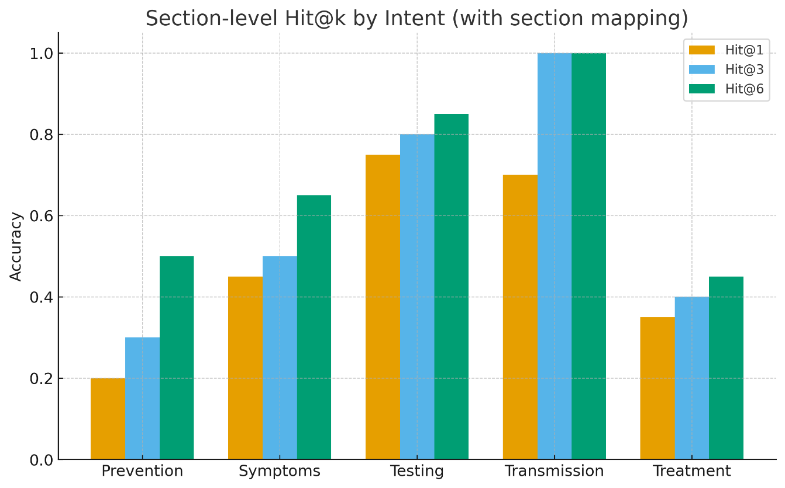
CHAPTER 4 - EXPERIMENTS AND EVALUATION
2. Evaluation
Intent | #Queries | Hit@1 | Hit@3 | Hit@6
Symptoms | 20 | 9/20 (45%) | 10/20 (50%) | 13/20 (65%)
Transmission | 20 | 14/20 (70%) | 20/20 (100%) | 20/20 (100%)
Testing | 20 | 15/20 (75%) | 16/20 (80%) | 17/20 (85%)
Treatment | 20 | 7/20 (35%) | 8/20 (40%) | 9/20 (45%)
Prevention | 20 | 4/20 (20%) | 6/20 (30%) | 10/20 (50%)
Overall | 100 | 49/100 (49%) | 60/100 (60%) | 69/100 (69%)

Slide 15
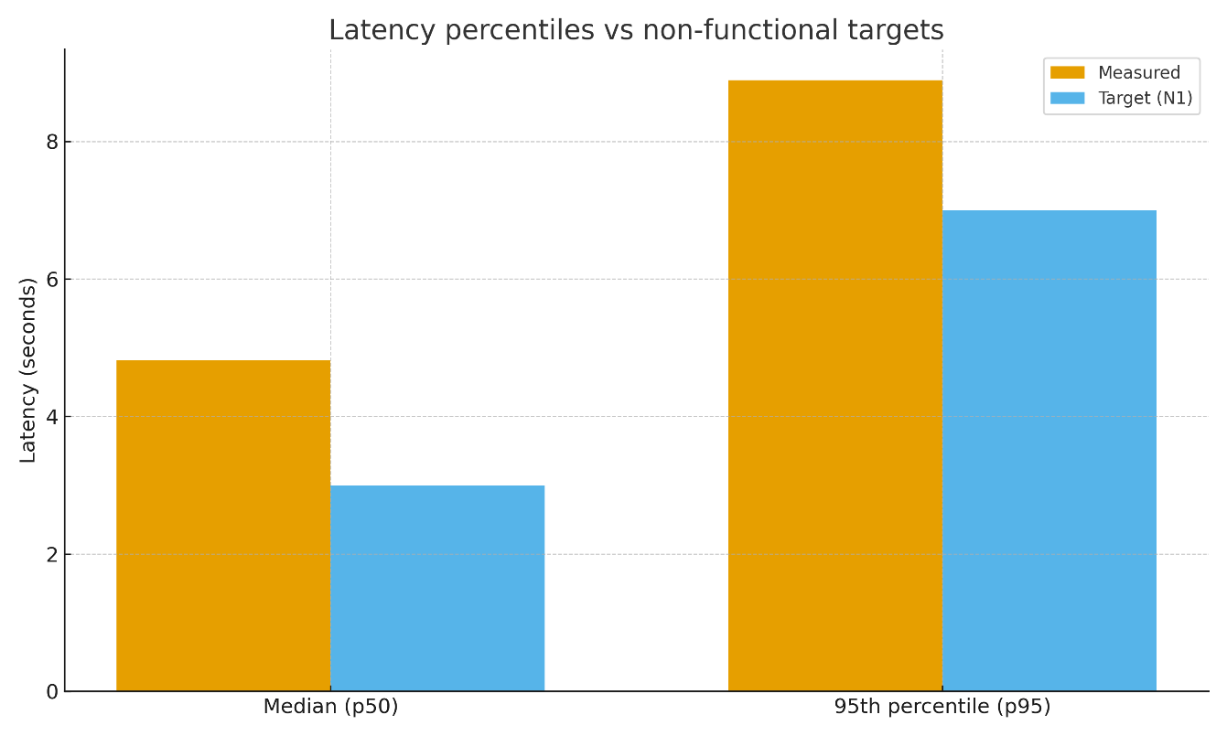
CHAPTER 4 - EXPERIMENTS AND EVALUATION
2. Evaluation

Slide 16
CHAPTER 5 – CONCLUSION AND FUTURE WORK
Conclusion
Future work
Built MedChat: STI chatbot using bilingual KB + hybrid RAG (BM25 + FAISS) + GPT-4o-mini.
Expand corpus (esp. Treatment/Prevention).
Achieved 49% Hit@1, 69% Hit@6; strong for Testing & Transmission, all answers passed safety rubric.
Improve retrieval/ranking.
Larger real-world evaluation.
Prototype is accessible & privacy-aware, latency acceptable for education.
Co-design with clinicians.

Slide 17
Thank you for your listening

Slide 19
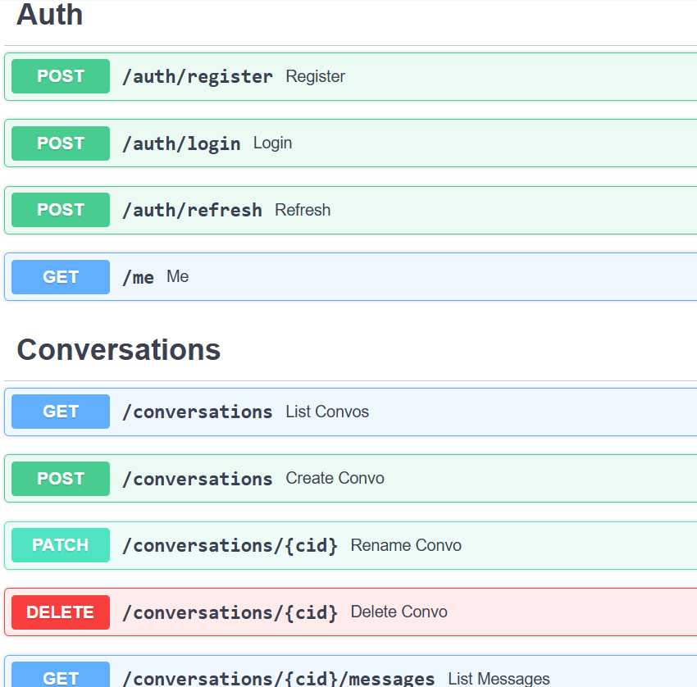
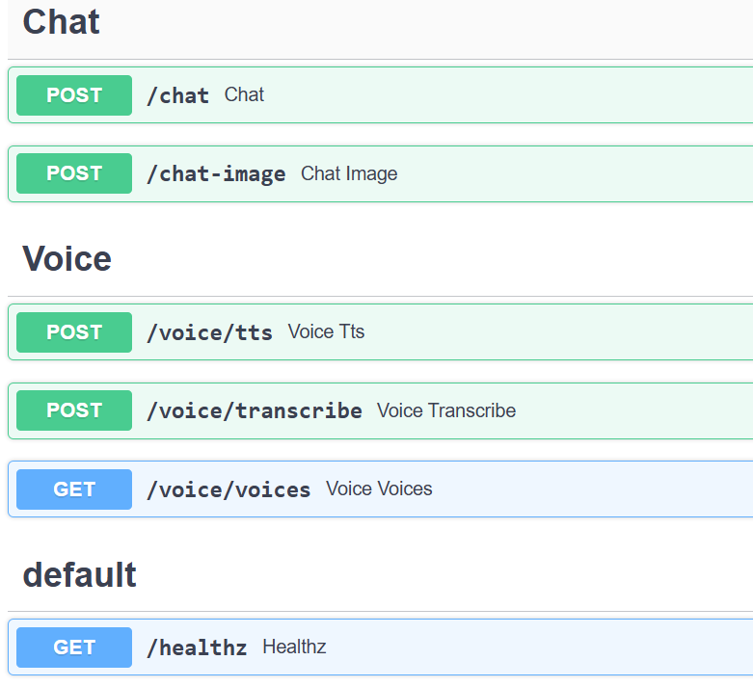
CHAPTER 3 - METHODOLOGY
3.2 Backend & API

Slide 24

CHAPTER 01 — INTRODUCTION
1.2 Target
research
Development of a bilingual STI chatbot.
1.3
Target audience: users aged 16–35 years who need to ask about sexually transmitted infections (STIs).
Location: Vietnam (Vietnamese preferred), English supported.
Time: 2025; data updated periodically according to CDC/WHO/NHS/Vinmec.
Object and
scope

Slide 25

CHAPTER 01 — INTRODUCTION
1.4 Method
Data preprocessing (CDC/WHO/NHS/Vinmec)
Recall BM25 + FAISS
RRF Fusion Top-K Context
GraphRAG (optional) Concept extension
Evaluation
1.5 Practical significance
Contribute to standardizing STI information in Vietnamese, increasing accessibility and reducing incorrect self-treatment.
Provide reusable technical solutions: hybrid retrieval + GraphRAG, source citation, security policy.
Create a foundation for real-world implementation at school/local level, expanding to other health consulting.

